Slide 1
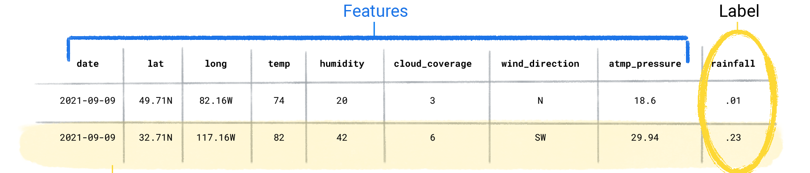
MACHINE LEARNING
Ability of Computer to learn from experience (training set),
to perform a task (label data) ,
when provided with newer data (testing set),
on a predefined performance measure (accuracy score).
1. Traditional Code: physics-based representation of the Earth's atmosphere and surface, fluid dynamics equations
2. ML Model: input weather data until the ML model eventually learned the mathematical relationship between weather patterns that produce differing amounts of rain.
We would then give the model the current weather data, and it would predict the amount of rain.

Slide 2
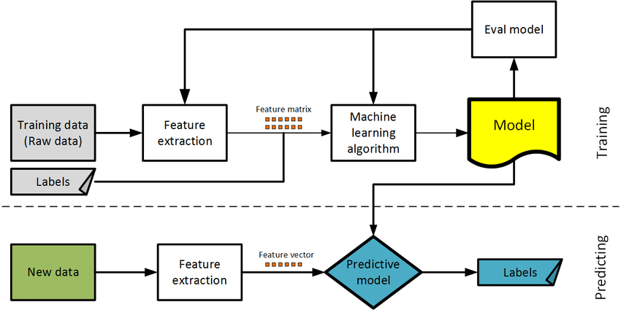
Machine Learning Model Workflow
A flowchart describing the development of a ML model.

Slide 3
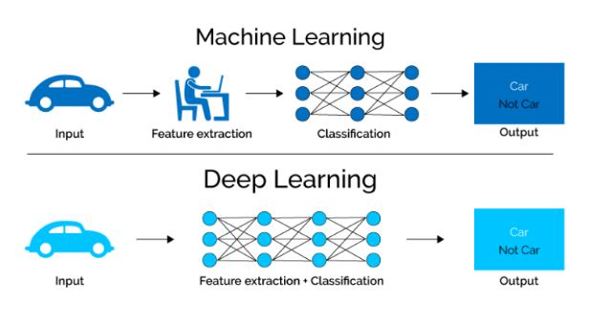
Exceed or mimic human intelligence
Unsupervised learning i.e. unlabelled data
Neural Networks e.g. Image recognition (brain tumors),
Speech recognition (different languages)
Supervised learning
e.g. Spam email, recommendation systems (Netflix)
Artificial Intelligence
Machine Learning
Deep Learning

